Slide 1
Family History Work on Both Sides of the Veil
2019

Slide 2
The Lord is Accelerating His Work
Missionary : Sanctifying : Temple & Family History
1 Nephi 14: 12 & 14
“and it came to pass that I beheld the Church of the Lamb of God, and its numbers were few, because of the wickedness and abominations…”
Vision
Notes:
Nephi was a unique prophet in that he was allowed to look forward through the corridors of time and he saw our day. There are 7 billion people on the earth and only 15-16 million (2/10 of 1 percent) are members. Many of those are less than faithful all due to the wickedness all around us.

Slide 3
The Lord is Accelerating His Work
Missionary : Sanctifying : Temple & Family History
1 Nephi 14: 12 & 14
“and it came to pass that I beheld the Church of the Lamb of God, and its numbers were few, because of the wickedness and abominations…”
Vision
I Nephi beheld the power of the Lamb of God, that it descended upon…the covenant people of the Lord who were scattered upon all the face of the earth; and they were armed with righteousness and with power in great glory
Notes:
However, He also saw that the faithful would be blessed with power and glory. President Nelson is encouraging us to rise up and become armed with that righteousness that Nephi saw.

Slide 4
The Lord is Accelerating His Work
Missionary : Sanctifying : Temple & Family History
Daniel 2: 35& 44
“And..shall the god of heaven set up a kingdom, which shall never be destroyed…and it shall stand forever”
“And became a great mountain and filled the whole earth”
Vision
Notes:
We live in an exciting time. All the prophets in previous dispensations had all their work end in general apostasy. Not so with this last dispensation. Never again will the priesthood be taken from the earth. The kingdom of God on the earth will grow to fill the entire earth and stand forever as prophesied by Daniel. We are blessed to come to the earth at a critical time and to play a critical role in bringing to pass that prophesy.
Today we will be discussing exactly what that role is, what the Lord has for us to do, and how He expects us to accomplish that mission.

Slide 5
It’s About the Plan
plan of salvation : plan of happiness : plan of eternal progress
Alma 12:32 “Therefore God gave unto them commandments, after having made known unto them the plan of redemption”.
Vision
Notes:
“It’s not fair for members to be asked to do work (family history work) when they don’t understand why they are doing the work.”
“To ask members to do Family History without context makes them feel like they are part a FamilySearch grinding machine”
Do you think the Lord wants 100% home teaching, or home teachers and those they teach to be progressing toward eternal life?
As consultants and helpers, our first objective must be to help those we are working with understand the Lords plan and their role in it. Not “What does the Lord want for his church?”, or this ward, but for them, personally and individually. What does He wan tthem to become through this work?

Slide 6
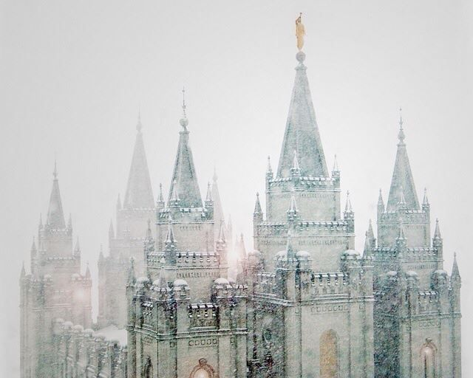
Gather Isreal
What is the great latter-day work?
Pres Nelson, Apr 2018
Vision
April 3 1836, Kirtland
Moses
Elias
Elijah
Keys of the
Gathering of Israel
Keys of
Abrahamic Covenant
Keys of the
Sealing Power
Missionary Work
Sanctifying the Gathered
Salvation of Living & Dead
Notes:
President Nelson has been very clear with the youth, and with all members, that the greatest thing happening on the entire face of the earth is the Gathering. That is our great task. The gathering started when keys were restored to the earth to carry out that work. It is more than just missionary work.
On April 3rd in the Kirtland temple, just following services with the members, Joseph and Oliver closed the curtains around the pulpit and began to pray. They were privileged with a visit from the savior in which He told them that thousands and tens of thousands would greatly rejoice in consequence of the blessings to be poured out.
Moses then visited them and conferred the keys of the gathering of Israel. This represents the missionary work and gathers the Lords children into the gospel through baptism.
Following Moses, Elias visited them and conferred the keys of the Abrahamic Covenant. The Abrahamic covenant promises great blessing upon the faithful and represents the sanctifying o those gathered into the church.
Lastly Elijah, visited them as prophesied by Malachi, and conferred the keys of the sealing power, gathering up all the faithful, living and dead, into celestial exaltation through temple covenants.

Slide 7
Lucifer will be Bound
D&C 45:55
And Satan shall be bound that he shall have no place in the hearts of the children of men.
Vision
Notes:
When we think about that future time when the Lord reigns personally on the earth and all are gathered and sanctified we often characterize that culture as Satan being bound. Many have a conception that he will be chained up, cast into a pit and not allowed to tempt the children of men. It is possible that some confuse the figurative with the actual. Satan will be bound figuratively not literally. Hew will still be allowed to roam the earth whispering and muttering and trying to deceive. However, he will have no power to do so because he will have no place in the hearts of the children of men. They will have dismissed him from their lives and tuned out to his temptations. They will no longer hear his voice, nor fall for his deceptions.

Slide 8
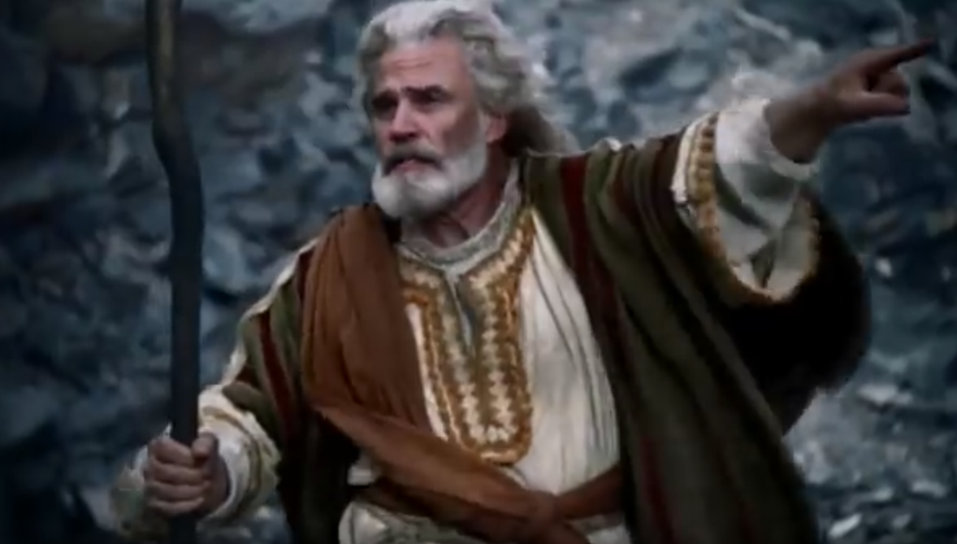
Moses 1:21
And Moses received strength, and called upon God, saying: In the name of the Only Begotten, depart hence, Satan
Vision
Notes:
How do we accelerate that great coming day by dismissing Satan from our lives.
Moses gives us an example. Moses is my hero. Too often, when I have been confronted with Satan tempting me to worship him and his falsehoods, I have found myself dabbling. Moses had a great vision in which the Lord taught him amazing things. When the vision withdrew, it took him several hours to recover his strength, but when he did, he came face to face with the destroyer.
Satan came saying “Moses, son of man, worship me”. Moses didn’t dabble. He went on for a dozen verses lecturing and ragging on Satan. “Where is thy glory that I should worship thee?, They glory is darkness unto me… I can judge between thee and God…I will not cease to call on God, I have other things I want to learn from him. Moses commanded Satan to “get thee sense and depart three times and Satan just go angrier and ranted and raved until Moses was scared. However, Moses “called upon God and saying: In the name of the only begotten, depart tense Satan.” With that Satan had to leave.
If we want to dismiss Satan from our lives we must do it in the name of the only begotten. However, that probably has less to do with pointing and commanding in aloud voice like Moses … and probably has more to do with this…

Slide 9
D&C 20:77
…that they are willing to take upon them the name of thy Son, and always remember Him…
Vision
Notes:
Each Sunday we covenant to take upon us the name of Christ. As we live up to that covenant Satan loses power over us and we tune out of His whisperings and mutterings and temptations.

Slide 10
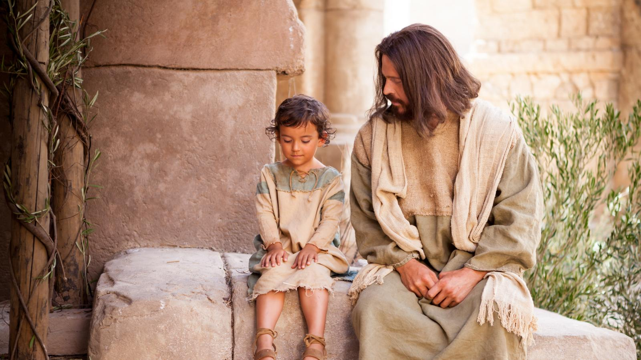
Vision
Think as Christ would think
Speak as Christ would speak
Act as Christ would act
Notes:
So what does it mean to take upon us the name of Christ?
It means that we always Think, Speak and Act as Christ would act in every circumstance. That is a tall order!!!
Sometimes Christ comforted and blessed. Other times he commanded and counseled. At times he rebuked and condemned. Several times he even grabbed a whip and drove out the wicked.
If we want to always know what we should think, say and do in every circumstance (with family, with friends, at work, with neighbors, etc) the only way we will be able to do that is through personal revelation. President Nelson has even said that we will not be Abel to withstand the events of the last days unless we increase our ability to receive personal revelation. It is a requirement for us to fully take upon us the name of the savior and to dismiss Satan from our lives.

Slide 11
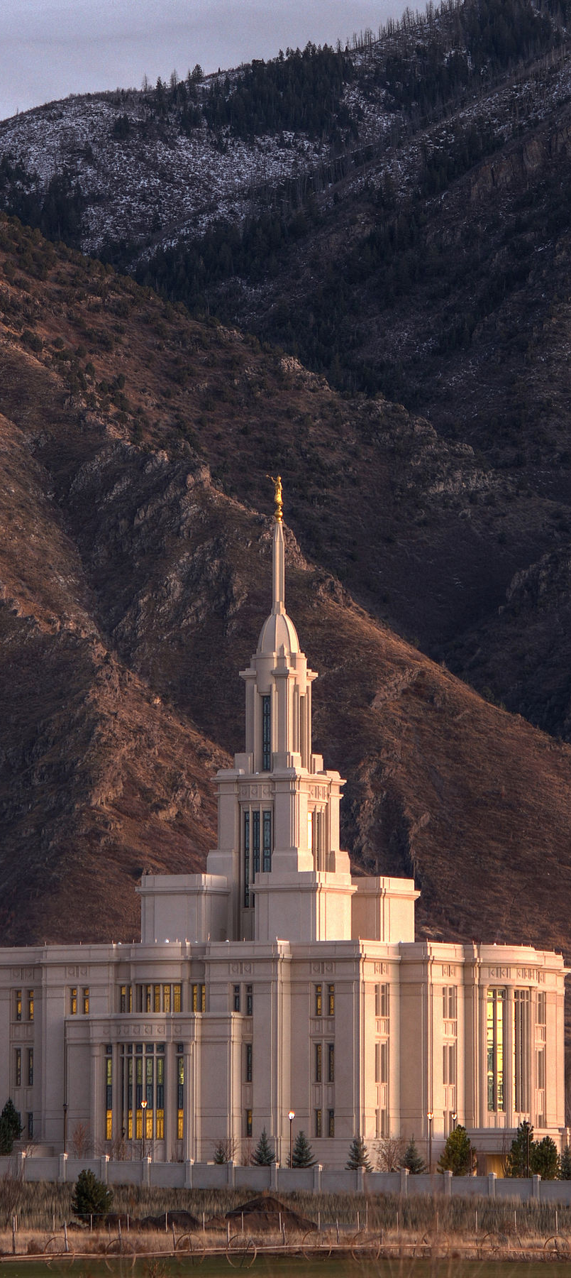
How Do We Learn Skills
Expert
Basketball
Piano
Virtuoso
Constant
Revelation
Vision
Notes:
Receiving revelation is a skill. It takes time to learn a skill and we would be unwise to wait until a spiritual or physical crisis to learn that skill.
How do we learn any skill?
If you wan too be great at basketball you need to be on the court a lot. You need to shoot 10,000 free throws and practice continually.
If you want to be an expert pianist, you need to be at the keys a lot and invest the time learning that skill
If you want to learn to receive personal revelation, it will behoove you to frequently be in the place where the veil is thin and where revelation flows freely.
Each time you go to the temple you will take more of that spirit with you and you will grow in the spirit of revelation.
In the temple we attend once for our own ordinances and thereafter for our ancestors and relatives…which brings us back to Family History work

Slide 12
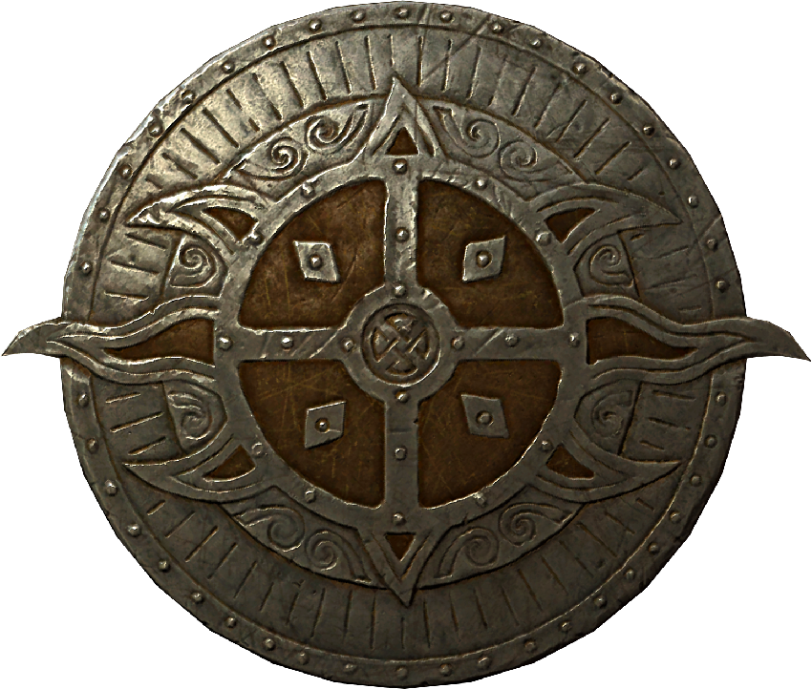
A Shield and a Protection
“No work is more of a protection to [us] than...genealogical research. ... No work is more spiritually refining. No work we do gives us more power. No work requires a higher standard of righteousness. Our labors...cover us with a shield and a protection.”
Boyd K Packer
The Holy Temple
Vision
Notes:
Boyd K Packer has said…
How does family history work act as a shield and a protection.
It is critical that we understand how that doctrine works.

Slide 13
A Shield and a Protection?
Vision
How?

Slide 14
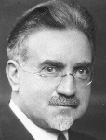
Help from Beyond the Veil
“Whoever seeks to help those on the other side receives help in turn in all the affairs of life…Help comes to us from the other side as we give help to those who have passed beyond the veil.”
John A Widtsoe
July 1931
Vision
Notes:
Elder John A Widstoe taught….
Many of us have experienced or heard of near miraculous assistance in finding ancestor records, and it is true that the veil is particularly thin when doing Family History work…however, that is not what Elder Widstoe is talking about.
He says that we will receive help in ALL THE AFAIRS OF OUR LIVES. At work, at home, with friends, in all our temptations, and challenges.
I think it is also important to understand that “Helping” those on the other side is likely more expansive than just providing temple ordinances. When we learn about them, document their lives, share their stories, learn to love them … Then they can help us.
Story of a 12 yr old who did the ordinances for her great grandmother.
“I went to the temple with my greatgrandmother and we both had a great time” she didn’t “take a name”, she went with her great grandmother.

Slide 15
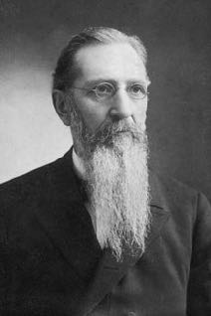
Helpers Known to Us
“When messengers are sent to minister to the inhabitants of this earth, they are not strangers, but from the ranks of our kindred, friends, and fellow-beings and fellow-servants”
Joseph F Smith
Gospel Doctrine p.435
Vision
Notes:
Who are the “They”
President Joseph F Smith explained that…
I do not know all the ways that our deceased ancestors can “help” is. Perhaps they can inspire, protect, strengthen, etc. I suspect that when we walk through the veil, we will likely be shocked at all the assistance that we received, and the involvement our family had in our lives, and we never realized it.

Slide 16
Agency is a Law of Heaven
“the Lord will force no man to heaven”
D&C 121:37
“when we undertake to…exercize control, dominion or compulsion upon the souls of men…the heavens withdraw themselves and the spirit of the Lord is grieved.”
Vision
Notes:
There is one additional principle that we must understand, however.
There is no control or compulsion in the Lord’s kingdom. He respects our agency perfectly….and all those in His service, including our ancestors, will be limited in how they can influence our lives without our use of our agency first.
If we want the shield and protection, the inspiration, the guidance and encouragement…or whatever they can do to bless us…we must first excursive our agency. We must first “help” them.
Those who are engaged in this work and are documenting, sharing and loving their ancestors lives…are the ones who will receive the great blessings of the plan.

Slide 17
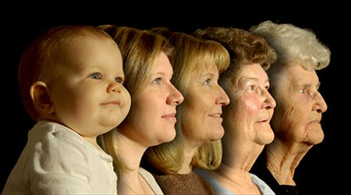
The Plan
Multi-generational families, on both sides of the veil working together…
…so each family member is identified, sanctified, and sealed up unto exaltation through the saving ordinances and covenants.
All are gatherers
Vision
Notes:
Both sides of the veil – We are the only organization on the earth that explains the plan for Heavenly Father's children on both sides of the veil.
Ancestors of people you are teaching are praying for the convert to help themselves, their ancestors, and their descendants.
We are not meant to walk through this life alone. We are not meant to confront Satan and all his temptations by ourselves. Getting through this life is meant to be a collaborative family affair with people on both sides of the veil working together to get their family members through this life, and exalted together.

